Slide 1
Cloud Computing (CSX-433)
Dr. Mohit Kumar
Assistant Professor

Slide 2
Syllabus
UNIT-I Introduction
Cloud-definition, benefits, usage scenarios, History of Cloud Computing Cloud Architecture, Types of Clouds, Business models around Clouds, Major Players in Cloud Computing, issues in Clouds, Eucalyptus, Nimbus, Open Nebula, CloudSim, Risks Involved in Cloud Computing.
UNIT-II Cloud Services
Types of Cloud services: Software as a service, Platform as a Service, Infrastructure as a Service, database as a Service, Monitoring as a Service, Communication as services. Service providers, Google, Amazon, Microsoft Azure, IBM, Salesforce.
UNIT-III Collaborating Using Cloud Services
Email Communication over the Cloud , CRM Management, Project Management, Event Management, Task Management, Calendar, Schedules, Word Processing, Presentation, Spreadsheet, Databases, Desktop, Social Networks and Groupware, Work Loan Management in Cloud.

Slide 3
Continue..
UNIT-IV Virtualization For Cloud
Need for Virtualization, Pros and cons of Virtualization, Types of Virtualization, System Vm, Process VM, Virtual Machine monitor, Virtual machine properties, Interpretation and binary translation, HLL VM Hypervisors, Xen, KVM, VMWare, Virtual Box, Hyper-V.
UNIT-V Other Ways to Collaborate Online
Collaborating via Web - Based Communication Tools - Evaluating Web Mail Services – Evaluating Web Conference Tools – Collaborating via Social Networks and Groupware - Collaborating via Blogs and Wikis.
UNIT-VI Security, Standards and Applications
Security in Cloud: Cloud security challenges – Software as a Service Security, Common Standards: The Open Cloud Consortium – The Distributed Management Task Force – Standards for application Developer – Standards for Messaging – Standards for Security, End user access to cloud computing, Mobile Internet devices and the cloud.

Slide 4
TEXT BOOKS, AND/OR REFERENCE MATERIAL
John Rittinghouse and James Ransome, Cloud Computing, Implementation, Management and Strategy, CRC Press, 2010.
Michael Miller, Cloud Computing: Web-Based Applications That Change the Way You Work and Collaborate Que Publishing, August 2008.
James E Smith, Ravi Nair, Virtual Machines, Morgan Kaufmann Publishers, 2006.
David E. Y. Sarna Implementing and Developing Cloud Application, CRC press 2011.
Lee Badger, Tim Grance, Robert Patt-Corner, Jeff Voas, NIST, Draft cloud computing synopsis and recommendation, May 2011.

Slide 5
Organization of the course
Attendance/quiz 10%
• Course Project 40%
• End semester online exam 50%
Attendance is compulsory (It will be used to decide the grades of borderline cases )

Slide 6
COURSE OUTCOMES
Upon successful completion of this course, the student will be able to perform:
Understand cloud computing models, namely, infrastructure as a service (IaaS), platform as a service (PaaS), and software as a service (SaaS).
Understand security implications in cloud computing.
Analyse the operation, implementation and performance of cloud computing systems, and the relative merits and suitability of each for complex data-intensive applications.
Analyse the trade-offs inherent in Cloud Computing.
Work in teams to contribute, evaluate, and feedback on case studies on different cloud computing solutions, ex: Baadal (IIT Delhi).

Slide 7
Cloud-definition
Definition of cloud by NIST:
“Cloud computing is a model for enabling ubiquitous, convenient, on-demand network access to a shared pool of configurable computing resources (e.g., networks, servers, storage, applications, and services) that can be rapidly provisioned and released with minimal management effort or service provider interaction”.
“Cloud computing is a collection of resources (combination of software and hardware) which is provided to the user on the pay per use basis over the internet”.

Slide 8
Continue..
“Cloud computing is the on-demand delivery of computing as a service where you pay only for the service you used”.
“The hardware and software services are available to general public, corporations and business market etc”

Slide 9
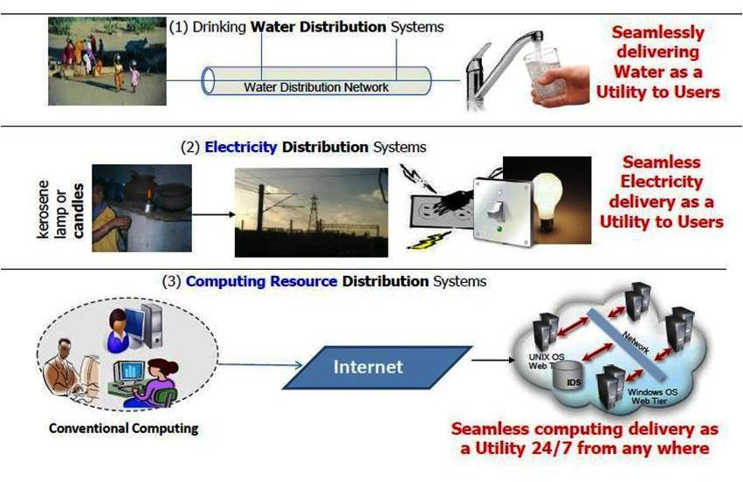

Slide 10
Characteristics of cloud computing
On-demand self-service: Cloud computing resources can be provisioned without human interaction from the service provider. This can be a storage space, virtual machine instances, database instances, and so on.
Broad network access: Cloud services are available over a network—ideally high broadband communication link—such as the internet, or in the case of a private clouds it could be a local area network (LAN).
Multi-tenancy and resource pooling: Cloud computing resources are designed to support a multi-tenant model. Multi-tenancy allows multiple customers to share the same applications or the same physical infrastructure while retaining privacy and security over their information.

Slide 11
Continue..
Rapid elasticity and scalability: Cloud computing is the ability to quickly provision resources in the cloud as manufacturing organizations need them. And then to remove them when they don’t need them.
Measured service: Cloud computing resources usage is metered and manufacturing organizations pay accordingly for what they have used. Resource utilization can be optimized by leveraging charge-per-use capabilities.

Slide 12
Why Cloud Computing?
It is forecast that between 50-60 billion devices will be added to the internet by 2025
•43 trillion gigabytes of data will be generated and will need to be processed in cloud data centers.
Increasing capacity means buying more servers/infrastructure.
Lead time for new capacity could be up to 1-2 years or more.

Slide 13
Need of Cloud Computing
Cloud computing is a new trend in computing due to its many benefits:
Reduced Costs
Scalability
Remote Access
Disaster Relief
Ease of Implementation
Skilled Vendors
Response Time
Easy to Customize
Virtual Provisioning
Fully Automated Storage Tiering—FAST

Slide 14
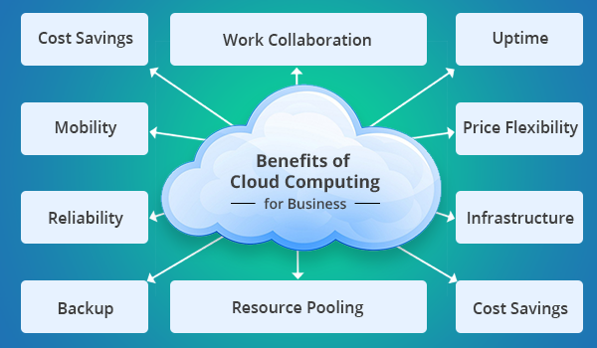
Benefits of cloud services

Slide 15
Benefits of Cloud Computing
Cloud computing offers the following benefits:
Pay as per use
Reduced investment and proportional costs
Accessibility from anywhere
Increased scalability
Increased availability and reliability
Dynamic provisioning

Slide 16
History of cloud computing
If we go through the chronological order, it has evolved after through a number of phases:
Mainframe computing:
Multiple users were capable of accessing a central computer through dumb terminals, whose only function was to provide access to the mainframe.
Because of the costs to buy and maintain mainframe computers.
it was not practical for an organization to buy and maintain one for every employee

Slide 17
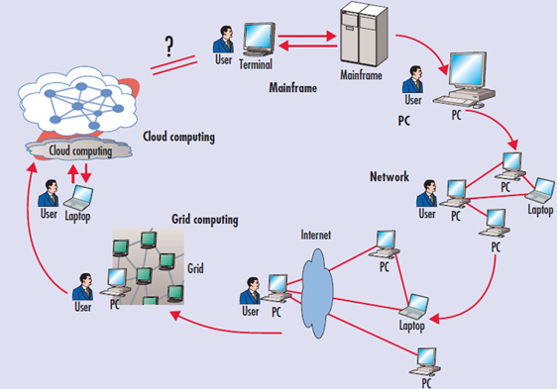
Evolution of Cloud Computing
Figure 1: Computing paradigm shift

Slide 18
Peer to Peer Approach
Peer-to-Peer (P2P) is a decentralized approach and it encompasses no principal server. It is a design in which every computer has equal responsibilities and facilities.
P2P facilitates straight swap of services and resources.
This kind of network is not simple to manage.

Slide 19
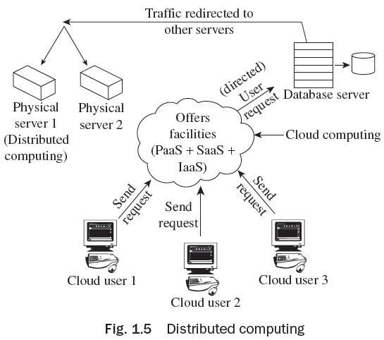
Distributed Computing
Distributed computing utilizes those idle resources that are not utilized for some reason or the other. Figure 1.5 shows distributed computing.

Slide 20
Concept of Virtual Machines (VMs)
Using virtualization software like VMware, it became possible to execute one or more operating systems simultaneously in an isolated environment.
The virtual machine (VM) operating system took the 1950s’ shared access mainframe to the next level,
Permitting multiple distinct computing environments to reside on one physical environment.
Virtualization came to drive the technology, and was an important catalyst in the communication and information evolution.

Slide 21
The following list briefly explains the evolution of cloud computing:
Grid computing: Solving large problems with parallel computing.
Utility computing: Offering computing resources as a metered service.
SaaS: Network-based subscriptions to applications.
Cloud computing: Anytime, anywhere access to IT resources delivered dynamically as a service

Slide 22
News on Cloud Computing
A mobile phone can be used to access services related to news.
Google Apps or Gmail is capable of seeking information via e-mail, rapidly from any tool. We can talk and work with partners or consumers without any language barrier.
Distribution and editing of data with trouble-free collaboration using Google items Docs and Sites.
Through Force.com, you may construct a scalable business application on the cloud platform.
Using online patterns for presentations, spreadsheets, and records.
Functioning steady, safe, and quick Web apps.
Easily and firmly distributing video in apps through Youtube for Google apps.

Slide 23
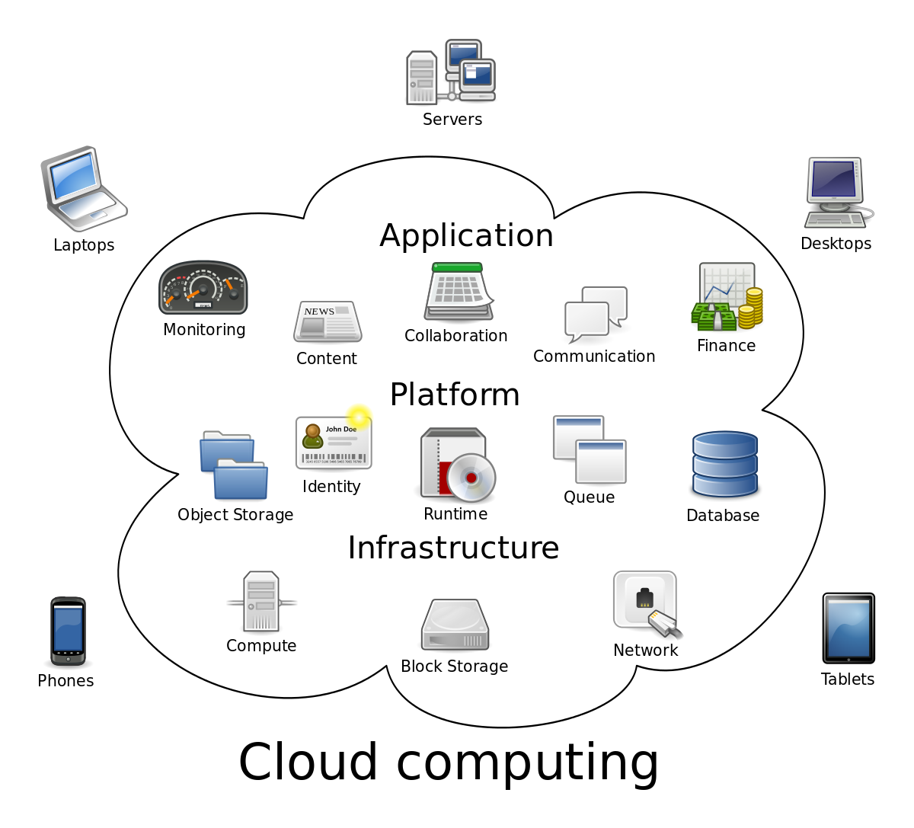
Cloud Architecture

Slide 24
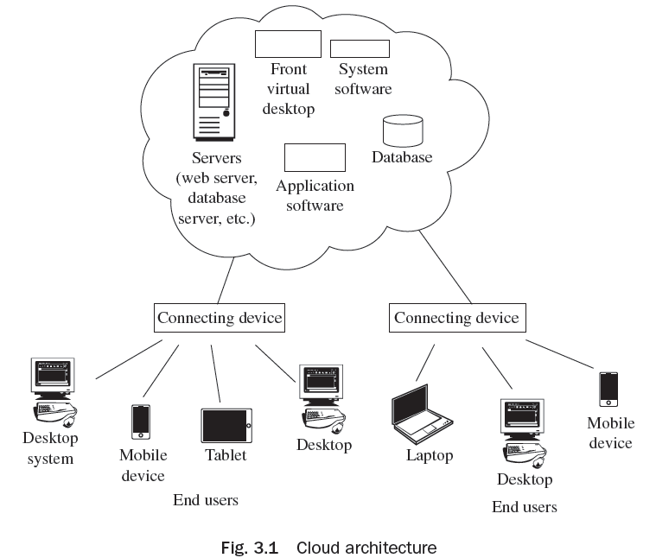
Cloud Computing Architecture
Basic cloud computing environment is shown in the Fig. 3.1 in which various services such as available servers, virtual desktop, system software, application software, database, etc. are available for cloud users. Users can avail the services using any device such as desktop system, laptop, mobile, tablet, etc.,

Slide 25
Cloud Computing Architecture
The Cloud Computing architecture is discussed based on different criteria:
On the Basis of Resource Provisioning
On the Basis of Resource Scheduling/Allocation
On the Basis of Load Balancing
On the Basis of Storage Management
On the Basis of Hypervisor Installed
On the Basis of Migration
On the Basis of Service Relocation
On the Basis of Failure Detection and Recovery

Slide 26
Similarities and Differences between Grid and Cloud Computing
Similarities:
Grid computing and cloud computing are scalable.
Grid and cloud computing offer service-level agreements (SLAs) for uptime accessibility of around 99 per cent. If the service slides below the definite uptime service level, the service credit for receiving data to the customer gets delayed.
Differences:
Cloud computing offers SaaS applications, whereas grid computing is used when the processing authority of service or an application is distributed across multiple systems.
With cloud computing, the corporation acquires feasibility and expense savings, whereas with grid computing the corporation acquires suppleness and authority.

Slide 27
Features of Cloud Computing
On-demand self service
Broad network access
Resource pooling
Rapid elasticity
Measured service
Multi-persistence
Dynamic Computing Infrastructure
Elasticity and scalability
IT service-centric approach
Standardized Interfaces

Slide 28
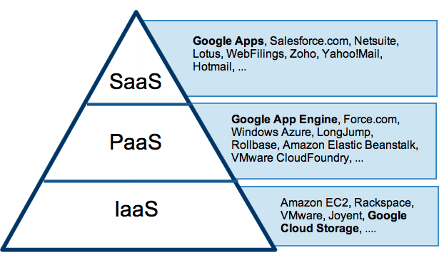
Figure 1.1 cloud computing service layers with example
Figure 1.1 cloud computing service layers with example
Cloud Service Layers
Cloud computing service layers with example
Notes:
28

Slide 29
Software as a Service
The capability provided to the consumer is to use the provider's applications running on a cloud infrastructure.
The applications are accessible from various client devices through either a thin client interface, such as a web browser (e.g., web-based email), or a program interface.
The consumer does not manage or control the underlying cloud infrastructure including network, servers, operating systems, storage, or even individual application capabilities, with the possible exception of limited user-specific application configuration settings.

Slide 30
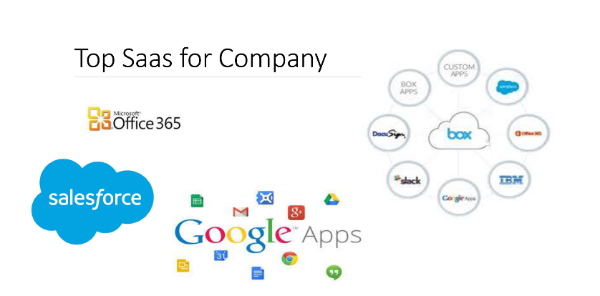

Slide 31
Platform as a service
PaaS vendors offer a development environment to application developers.
The provider typically develops toolkit and standards for development and channels for distribution and payment.
In the PaaS models, cloud providers deliver a computing platform, typically including operating system, programming-language execution environment, database, and web server.
Application developers develop and run their software on a cloud platform instead of directly buying and managing the underlying hardware and software layers.

Slide 32
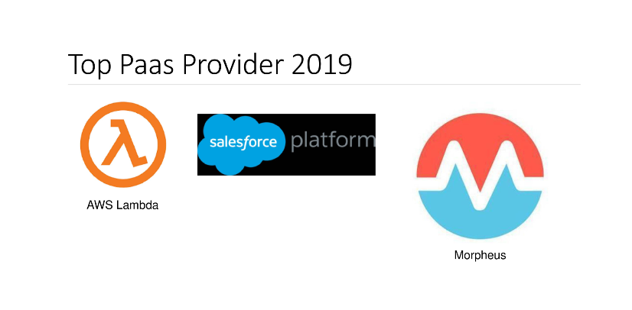

Slide 33
Infrastructure as a Service
IaaS is the delivery of technology infrastructure as an on demand scalable service
Usually billed based on usage
Usually multi tenant virtualized environment
Can be coupled with Managed Services for OS and application support

Slide 34
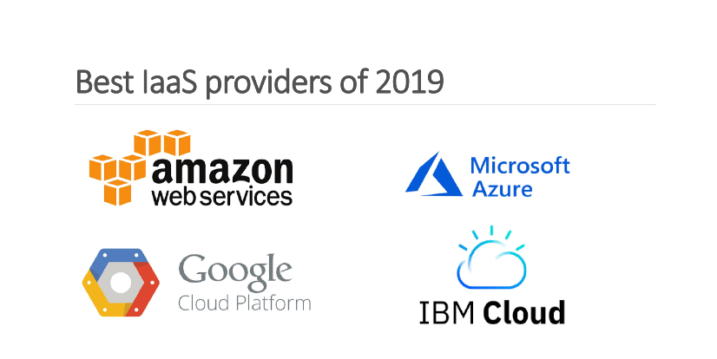

Slide 35
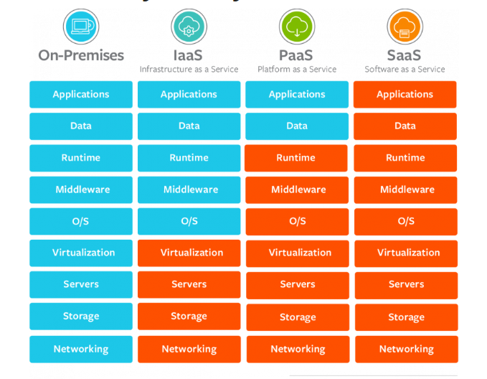

Slide 36
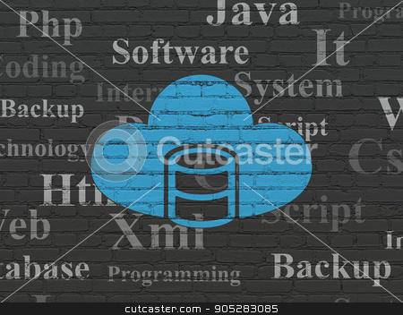
Cloud database
A cloud database is a type of database service that is built, deployed and delivered through a cloud platform.
Cloud databases typically run on a cloud computing platform

Slide 37
Deployment models
There are 2 primary ways to run a database in a cloud:
Virtual machine image
Database as a service (DBaaS)

Slide 38
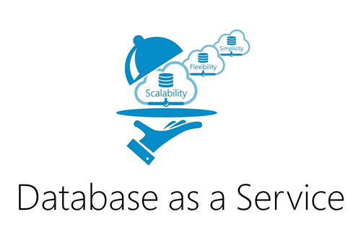
Database as a service (DBaas)
With this model, owners don't have to install and maintain the database themselves.
Instead the provider takes responsibility for installing and maintaining the database, while the owner gets appropriately charged

Slide 39
Data model
The design and development of typical systems utilize data management and relational databases as their key building blocks
Advanced queries expressed in SQL work well with relational databases
However relational database technology was not initially designed or developed for use over distributed systems

Slide 40
Modern relational databases have shown poor performance on data-intensive systems, and so has risen the idea of utilizing NoSQL with database management systems
Within the NoSQL implemented storage, there are no requirements for fixed table schemes
NoSQL databases provide efficient horizontal scalability, good performance and ease of assembly into cloud applications
It is important to differentiate between relational cloud databases as to opposed non-relational or NoSQL databases

Slide 41
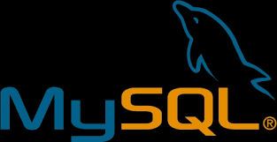
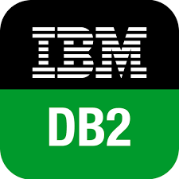
SQL databases
Relational databases, can either run in the cloud or a virtual machine as a service

Slide 42
NoSql databases
Are another type of database which can run in the cloud.
They are built to service heavy read/write loads and can scale up and down easily
But most contemporary applications are built on a SQL data model so working with NoSQL can require complete rewrite of application code

Slide 43
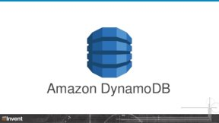
A multi model database provides a SQL interface to users and thus facilitates the usage of such databases for contemporary applications built around a SQL data model.

Slide 44
Background
Delivering Monitoring-as-a-Service
Similar to other cloud services
Database service (e.g. SimpleDB, Datastore)
Storage service (e.g. S3)
Application service (e.g. AppEngine)
Various benefits
End-to-end support, easy to use
Well maintained, reliable service
Sharing of implementation (template implementation)

Slide 45
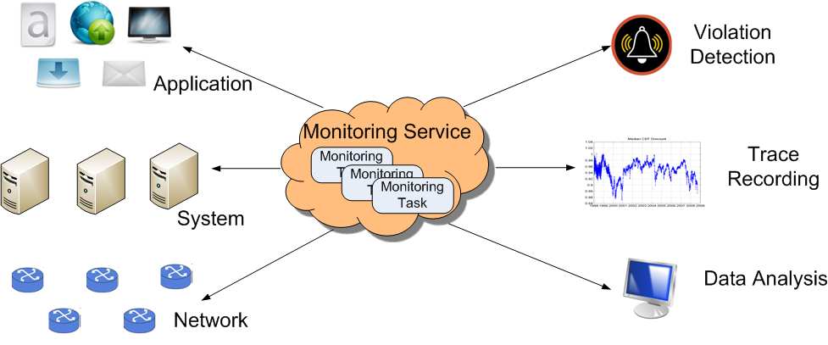
Background
A high-level view of the cloud monitoring service

Slide 46
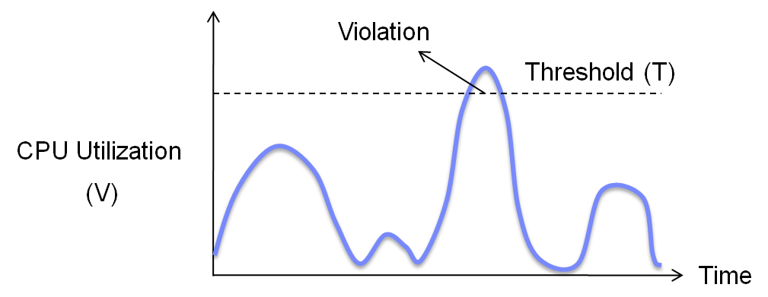
Continue..
State Monitoring
Monitoring the state of a system / application / service
E.g. CPU utilization, average response time, etc.
Violation: V > T

Slide 47
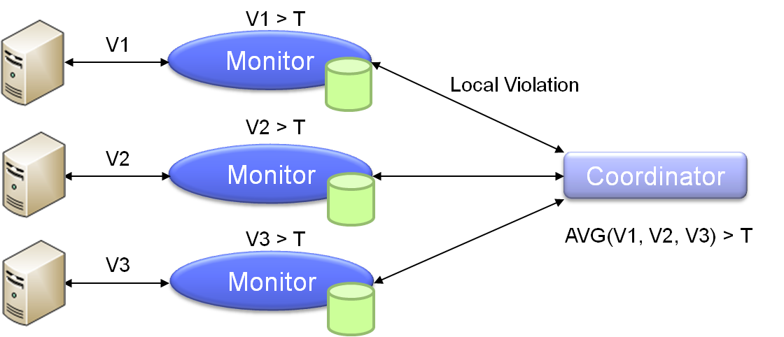
Continue..
Distributed State Monitoring
State value V is aggregated across multiple objects
Monitor and coordinator
An example of web server monitoring (average CPU utilization)

Slide 48
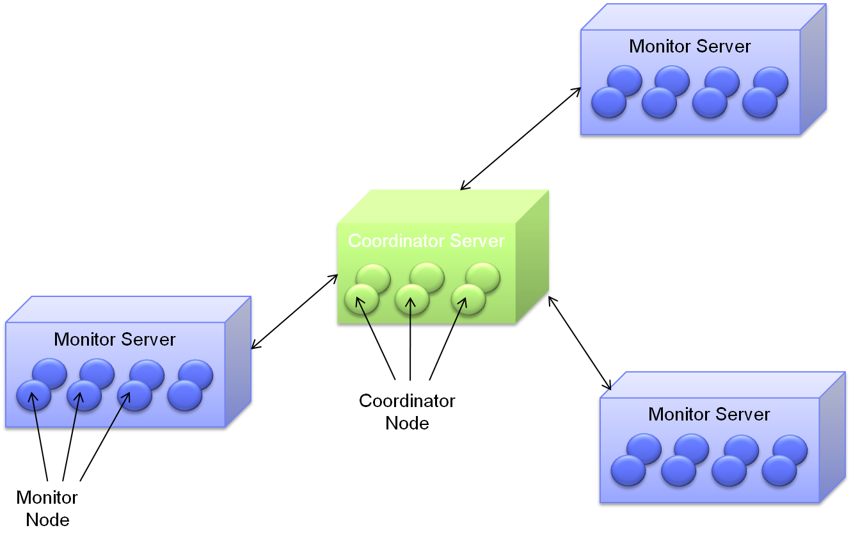
Architecture
Monitor Server
Coordinator Server

Slide 49
Challenges at System Level
Efficient Scalability
Supporting tens of thousands of monitoring tasks
Cost effective: minimize resource usage
Monitoring QoS
Multi-tenancy environment
Minimize resource contention between monitoring tasks

Slide 50
Efficient Scalability
Massive Scale
Many monitoring tasks are inherently large scale
E.g. SLA monitoring
A large number of users
Infrastructure monitoring
Application monitoring
Monitoring tasks with high cost
E.g. Distributed heavy hitter detection based on netflow data
Cost Effectiveness
Monitoring is a facilitating service
Use few machines as possible

Slide 51
Challenges at User Level
Budget-Aware Monitoring
Allow dynamic monitoring resolution based on available budget
Distributed Continuous Violation Detection
Meets the need of different detection model
Achieve efficiency at the same time

Slide 52
Budget-Aware Monitoring
Cloud and “Pay-as-You-Go”
Directly associate computing cost with monetary cost
Allow flexible provisioning based on available budget
Overhead in Cloud Monitoring
Violation processing cost
E.g. provisioning new servers when detects performance degradation
Also consumes cloud users’ budget

Slide 53
What is Communication as a Service?
Communication as a Service (Caas) is a method of delivering communication services in a method akin to Software as a Service delivery, but with some special considerations relating specifically to communications applications and the integration with proprietary communications systems.
CaaS can include a range of communications services, including voice over IP (VoIP), instant messaging, message routing, call recording and video conferencing.

Slide 54
Who is CaaS for?
Many people are familiar with consumer CaaS solutions such as Skype, FaceTime and instant messaging tools such as Facebook Messenger. However, mainstream adoption of communications over the public internet has been relatively slow.
It’s worth noting here that VoIP isn’t necessarily a public-internet solution; it could just as easily be used over dedicated circuits or LAN/WAN.

Slide 55
Business users have benefitted from the cost advantages of VoIP largely by deploying on-site IP-based PBX systems.
These offer significant cost advantages by enabling the business to run the corporate telephony system on the same network as is used for data; thereby eliminating the need to install and operate separate networks for voice and data.
However, these systems are expensive to purchase, configure and manage – putting them out of reach of most small-to-medium-sized businesses (SMBs).
By eliminating the need for businesses to purchase and maintain such expensive communications hardware, CaaS puts much greater options for communication management in the hands of SMBs

Slide 56
What are the advantages of CaaS?
CaaS offers the potential to manage multiple services – voice, video, data – over multiple devices – landline telephone, mobile or smartphone, PC – in a controlled environment.
It offers greatest potential for small businesses – enabling the utilisation of VoIP, VPNs, PBX and unified communications without the need for to invest in the upfront costs of the hardware or the need to employ the skilled professionals required to manage and maintain the systems.

Slide 57
Some argue “VoIP is an upgrade for your business… whether you need to open a new office on the other side of the country, adjust your business hours on the fly, or prioritise calls from your most important contacts, online telephony makes it possible to adjust how you work as you work.”

Slide 58
Are there any risks involved in CaaS?
The quality and the reliability of these solutions is of primary concern, given the mission critical nature of telephony and other communications services.
What do I need to do before implementing Communications as a Service?

Slide 59
Region and Availability Zones
Availability Zones is collection of data centers.
All the datacenters should be located in same building or same city.
A region consists of multiple availability zones.
Failure of one availability zone does not impact at other availability zone.
How to decide that which region/availability zone would be best for services/business purpose.
Latency
Cost
Energy
Service availability

Slide 60
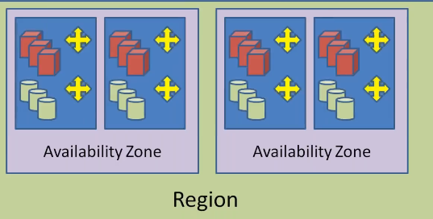

Slide 61
Cloud- Deployment Models
Public cloud
Public cloud services are available for general public over the internet. Amazon elastic compute cloud, Google appEngine, Window azure service platform etc are examples of public cloud those offered the services either pay per use basis or free
Private cloud
A private cloud environment is often the first step for a corporation prior to adopting a public cloud initiative.
Hybrid cloud
A hybrid cloud environment consists of some portion of computing resources on-site (on premise) and off-site (public cloud).
Community cloud
A community cloud is formed when several organizations with similar requirements share common infrastructure.
Notes:
61

Slide 62
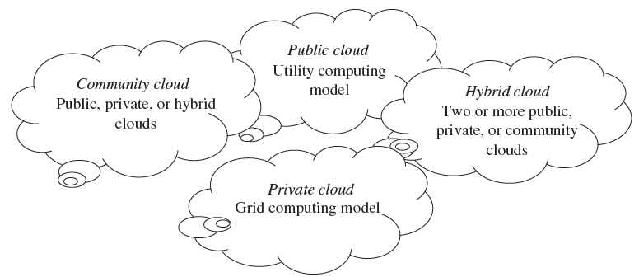
Continue…
The cloud model is invented with four deployment models—public cloud, private cloud, hybrid cloud, and community cloud.)

Slide 63
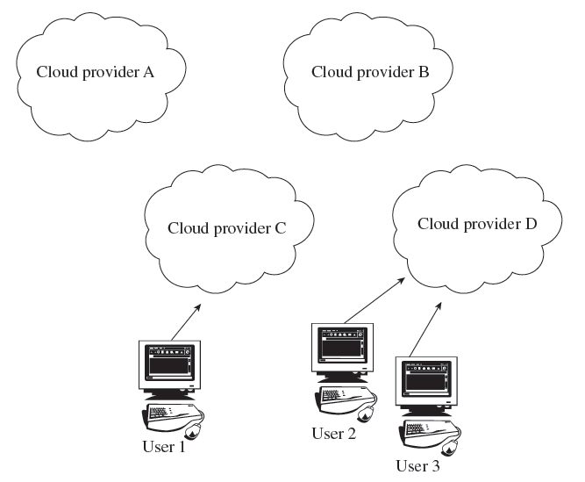
Public Clouds
The public cloud is the first deployment model. In this model, users have many options to opt for and decide on any service provider as per requirement.
Examples of public cloud vendors include
Google, Amazon Elastic Compute Cloud,
Windows Azure Services Platform,
Microsoft, etc.
This model assists in the reduction
of capital expenses and removes
equipped IT expenses.

Slide 64
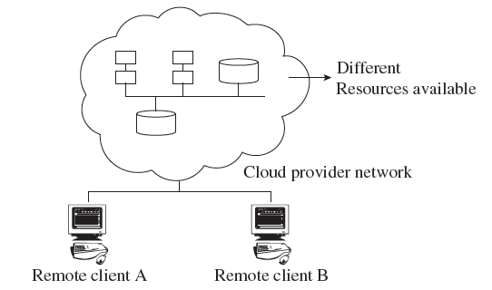
Private Clouds
The private cloud offers several advantages of an open cloud computing setting that comprises its service support and flexibility.
Private clouds allow infrastructure to be accessed only by the members of the organization and granted by third parties.
Examples of private cloud include Eucalyptus
cloud computing infrastructure with Ubuntu
Server, Elastra private-cloud, Vmware,
Microsoft, etc.

Slide 65
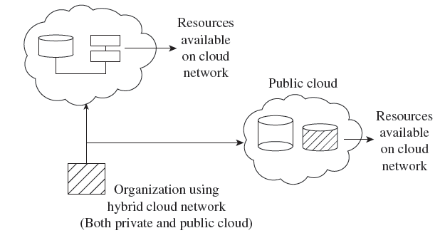
Hybrid Clouds
The hybrid cloud is a combination of a private and public cloud which is mutually dependent on one another.
In this model, cloud users are supplied with information on the public cloud, in spite of the reality that the cloud supplier has to maintain the company-significant services and information in a few
instructions.

Slide 66
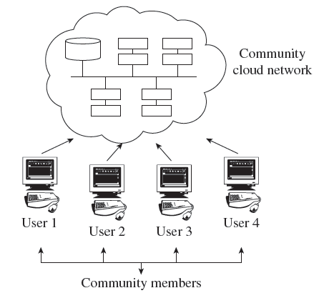
Community Clouds
A community cloud falls between public and private clouds category.
The drawback related to a community cloud is that of having costs higher than a public cloud.
Examples of community cloud include
Google’s ‘Gov Cloud’, NASA Nebula cloud,
etc.

Slide 67
List of Cloud Service Providers
Amazon Web Service (AWS)
Microsoft Azure
Google Cloud Platform
IBM Cloud Services
Adobe Creative Cloud
Kamatera
VMware
Rackspace
Red Hat
Salesforce
Oracle Cloud
SAP

Slide 68
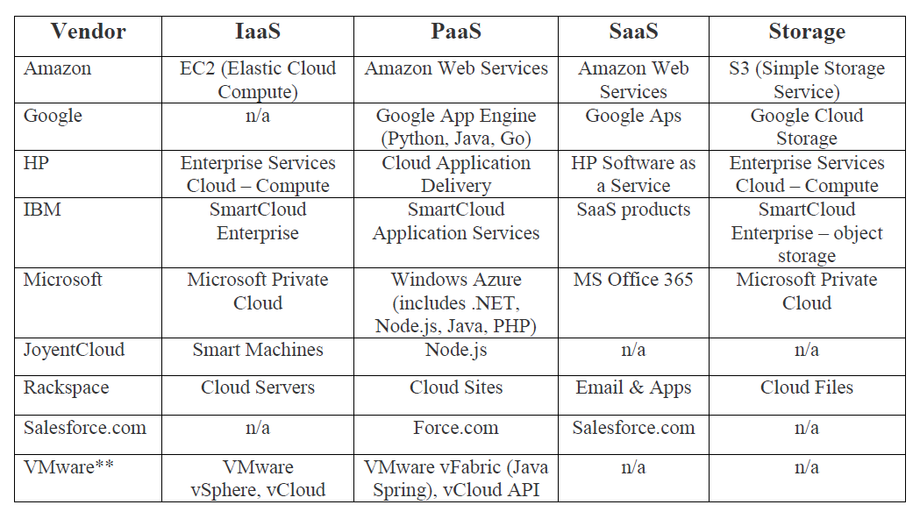
Major Cloud Computing Vendors

Slide 69
Vendors of Cloud Computing
Amazon Web Services—IaaS
Google—SaaS, PaaS
Microsoft Azure Service Platform—PaaS
Rackspace—Cloud Hosting
Salesforce.com—SaaS, PaaS

Slide 70
Amazon Web Services
AWS reported that it expects revenue in the annualized rate of $43 billion – and that it enjoyed 29% growth rate.
The challenge for AWS in its rivalry with the other top cloud vendor, Microsoft Azure, is that Microsoft has historically had a closer relationship with the enterprise.
Yet AWS has largely overcome this advantage by sheer depth and quality of its cloud-based toolset.
VMware Cloud on AWS is a virtualization technology that allows companies (especially larger, slower moving companies) as bridge from the traditional data center to the public cloud, which is AWS specialty.

Slide 71
Microsoft Azure
Microsoft’s Azure is number two, but Azure is essentially a head to head competitor with AWS.
Azure is strong in hybrid cloud – a critically important offering for companies with a large data center investment, an expensive facility they need to pair with a remote public cloud.
Azure has a top-notch PaaS offering that integrates with its public cloud.
Azure is well positioned to serve cloud customers as automation and AI become dominant.
Azure Machine Learning is a full-featured production platform, enabling the creation of all manner of customized algorithms and ML solutions.

Slide 72
Google Cloud Platform
GCP has a robust IaaS offering with a deep technical strength from its dominance in the search market.
Starting with strength in networking and automation, GCP offers arguably the sector’s greatest strength in AI, machine learning and – particularly – data analytics.
GCP has not been closely aligned with enterprise customers, a situation the company is working to correct.
As such, the move toward multicloud is good news for GCP; if it can’t be a company’s primary cloud platform, it will certainly be “one of” a company’s cloud providers.
GCP can then use this foothold to gain greater marketshare.

Slide 73
Limitations of Cloud Computing
Availability of Services
Internet Connection
Network Connection Dependency (Low Bandwidth)
Limited Features (Free of cost)
Loss of Control
Latency
Vendor lock-in
Energy Consumption
Scaling Resources
Security
Unpredictable Performance
No Technical support Available

Slide 74
How to develop Cloud Computing
For the development of cloud infrastructure, the following are needed:
Understanding the prevailing conventional data center
Computing resources that will be virtualized
Installing service administration devices

Slide 75
Core Components of Traditional Data Centers
Application Program employed to carry out numerous computing functions. It may be an operating system, DBMS, and many more.
DBMS It is an administration system which offers the ability to save or get data from rationally prepared tables.
Compute Resources which work numerous applications using various elements.
Storage This is used to save data for often use.
Network It is the ability to communicate among systems. It assists us to share data and resources.

Slide 76
Eucalyptus, Nimbus & OpenNebula

Slide 77
Eucalyptus, Nimbus & OpenNebula are major Open-Source Cloud-Computing Software Platforms.
Manage the provisioning of virtual machines for a cloud providing IaaS.
Commercial cloud services charge, by the hour, for CPU time.
It might be more cost effective for the organization to purchase hardware to create its own private cloud.
These software products are designed to allow an organization to set up a private group of machines as their own cloud.
These three frameworks represent three different points of interest in the design space of this particular type of open source cloud.

Slide 78
Analysis
We will discuss how these software frameworks act as managers that stand in the middle of a number of other software components.
We will analyze how core decisions in the basic architecture and overall structure of Eucalyptus, Nimbus and OpenNebula impact the kind of settings and applications for which each framework is most suitable.
We will identify several opportunities for improving these software stacks by identifying some of the challenges that are common to all three.

Slide 79
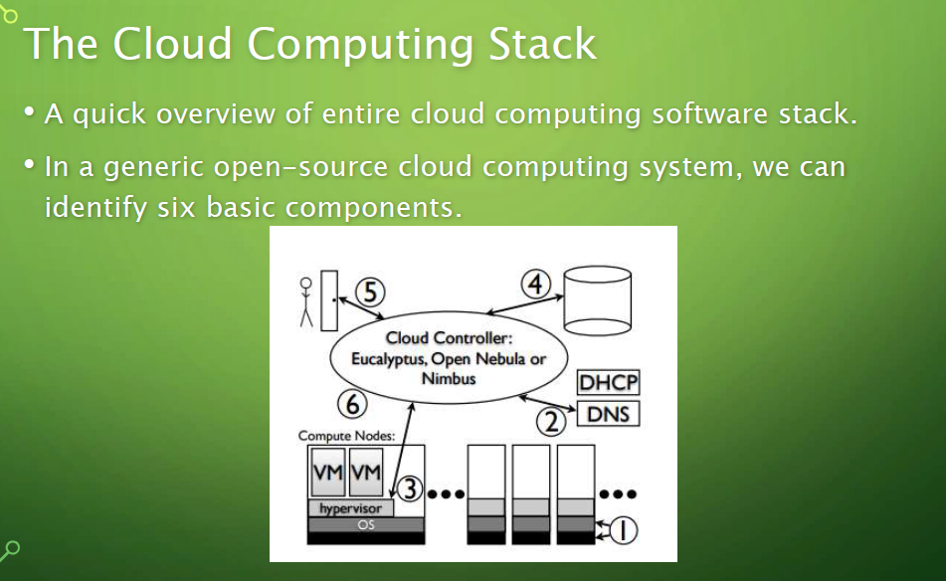

Slide 80
First, we hardware and operating system that are on the various physical machines in the system.
The second component is the network. This includes the DNS, DHCP and the subnet organization of the physical machines.
The third component is the virtual machine hypervisor, (also known as a Virtual Machine Monitor or VMM).
The fourth component is an archive of VM disk images.
The fifth component is the front-end for users.
The last component is the cloud framework itself, where Eucalyptus, OpenNebula and Nimbus are placed.

Slide 81
Eucalyptus
EUCALYPTUS stands for Elastic Utility Computing Architecture for Linking Your Program To Useful System.
It is open source software that was developed by University of California-Santa Barbara for Cloud Computing to implement Infrastructure as a Service.
Eucalyptus provide an EC2 -compatible cloud Computing Platform and S3- compatible Cloud Storage thus its services are available through EC2/S3 compatible APIs.
The Eucalyptus system is composed of a 5 main components interacting together; Client, Cloud Controller, Storage Controller (Walrus), Cluster Controller and a Node Controller

Slide 82
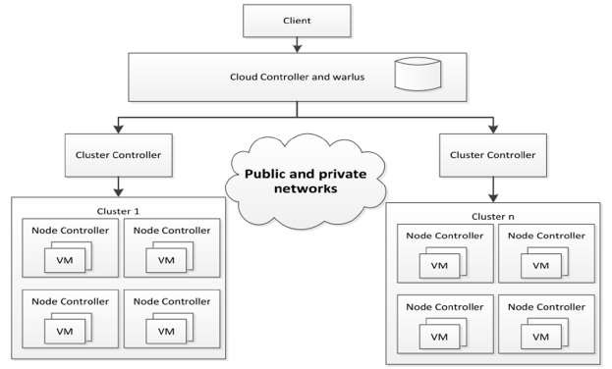

Slide 83
Node Controller
Is installed in each compute node to control VM activities, including the execution, inspection and termination of VM instances.
Cluster Controller
Runs on 1 machine per cluster & works as an intermediary between the cloud & node controller.
Storage Controller
Warlus is a component that provides storage services for storing virtual machine images and user’s data.
Cloud Controller
It is the user’s entry point into the Eucalyptus system and only one instance is run on the system. It provides users with a way managing the system.

Slide 84
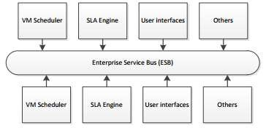
The cloud controller is built using the Enterprise service bus providing decoupling from the services’ implementation.

Slide 85
The client component provides the user with a way to access the Eucalyptus system (cloud controller).
Eucalyptus provides two interfaces;
One is a WDSL which is a SOAP client interface similar to AWS EC2 interface
called euca2ools.
Another interface is a HTTP query based interface

Slide 86
Constructing a Virtual Machine
A user uses the euca2ools front-end to request a VM.
The VM template disk image is pushed to a compute node.
This disk image is padded to the correct size and packaged for use by the hypervisor on the compute node.
The compute node sets up network bridging to provide a virtual NIC with a virtual MAC.
On the head node the dhcp is set up with the MAC/IP pair
VM is spawned on the VMM.
The user can now SSH directly into the VM.

Slide 87
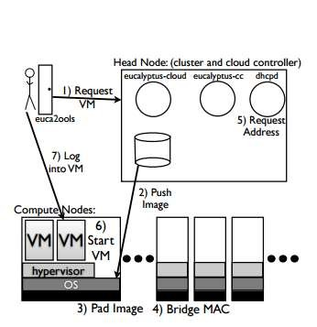

Slide 88
Nimbus
Nimbus is another open source IaaS implementation framework which came online September 2005.
Nimbus allows a client to lease remote resources by deploying virtual machines (VMs) on those resources and configuring them to represent an environment desired by the user.
It was formerly known as the "Virtual Workspace Service" (VWS) but the "workspace service" is technically just one the components in the software collection.
Nimbus was designed with the goal of turning clusters into clouds mainly to be used in scientific applications.

Slide 89
The design of Nimbus which consists of a number of components based on the web service technology
1. Workspace Service
Allows clients to manage and administer VMs by providing to two interfaces;
One interface is based on the web service resource framework (WSRF)
The other is based on EC2 WSDL.
2.Workspace Resource Manager: Implements VM instance creation on a site and management.

Slide 90
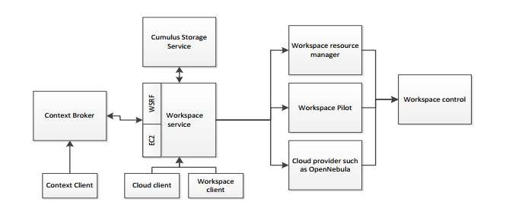
System Architecture And Design

Slide 91
3. Workspace Pilot: Provides virtualization with significant changes to the site configurations.
4.Workspace Control: Implements VM instance management such as start, stop and pause VM. It also provides image management and sets up networks and provides IP assignment.
5. Context Broker: Allows clients coordinate large virtual cluster launches automatically and repeatedly.
6. Workspace Client: A complex client that provides full access to the workspace service functionality.
7. Cloud Client: A simpler client providing access to selected functionalities in the workspace service.
8. Storage Service: Cumulus is a web service providing users with storage capabilities to store images and works in conjunction with GridFTP.

Slide 92
Constructing A Virtual Machine
A user uses cloud-client to request a VM.
Nimbus will SSH into a compute node.
The VM template disk image is pushed to the compute node.
On the compute node, the disk image is
padded to the correct size and configured.
The compute node sets up network bridging to provide a virtual NIC with a virtual MAC.
A dhcp server on the compute node is
configured with a MAC/IP pair.
VM is spawned on the VMM.
The user can now SSH directly into the VM.

Slide 93
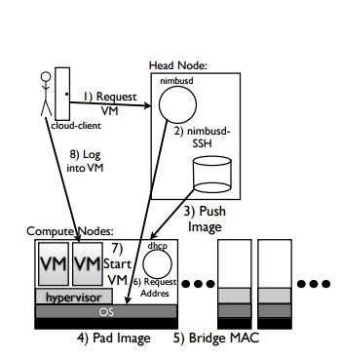

Slide 94
OpenNebula
OpenNebula tends to a greater level of centralization and customizability (especially for end-users).
The idea of OpenNebula is a pure private cloud, in which users actually log into the head node to access cloud functions.
OpenNebula, by default, uses a shared file system, typically NFS, for all disk images files and all files for actually running the OpenNebula functions.
In order to spawn a VM, the user provides a configuration file containing parameters which would be fed into the VMM command line. This allows for memory, processor, network and disk resources to be requested for essentially any configuration.
OpenNebula is also very centralized, especially in its default

Slide 95
Constructing A Virtual Machine
A user uses ssh to login to the head node.
The user uses the onevm command to request a VM.
The VM template disk image is copied and a copy is padded to the correct size and configuration within the NFS directory on the head node.
The one process on the head node uses ssh to log into a compute node.
The compute node sets up network bridging to provide a virtual NIC with a virtual MAC.
Files needed by the VMM on the compute node will be pulled to the compute node via the NFS.
VM is spawned on the VMM.
The user can now SSH directly into the VM.

Slide 96
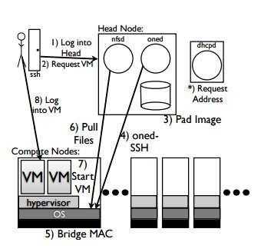

Slide 97
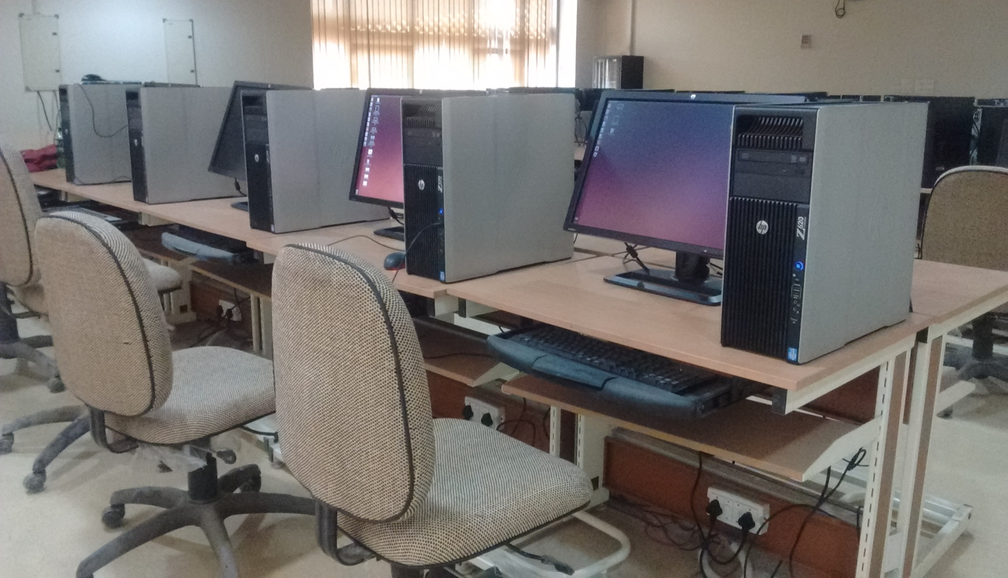
Private Cloud Computing Lab
IIT Roorkee
Figure 5.0 A Private Cloud Lab

Slide 98
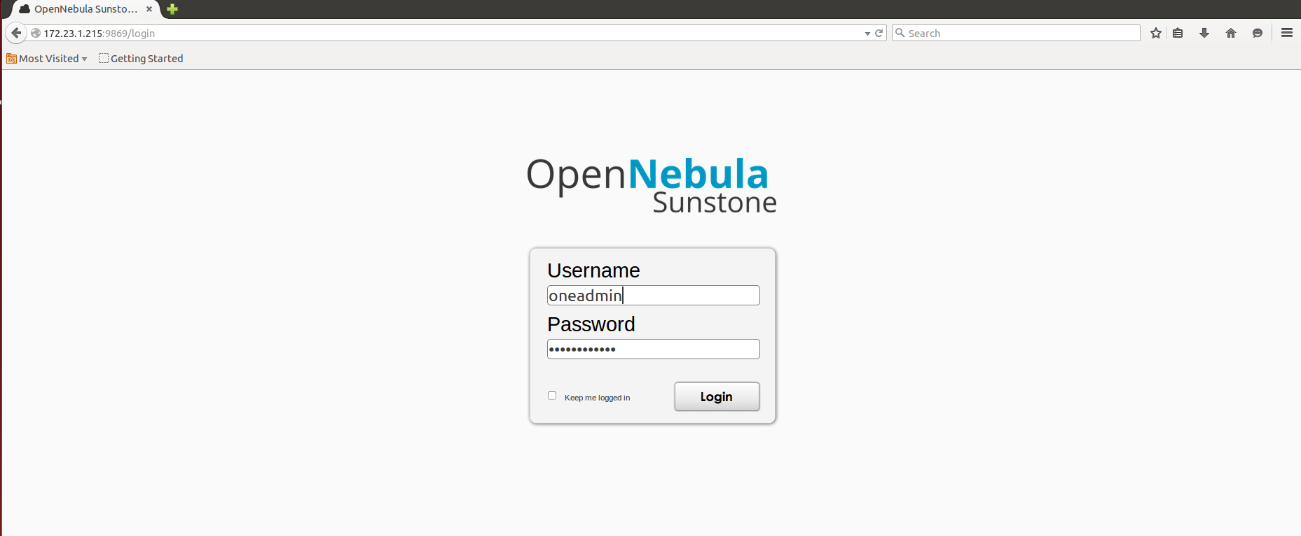
OpenNebula : Login Page (GUI)
Figure 6.0 A Cloud login page with GUI functionality

Slide 99
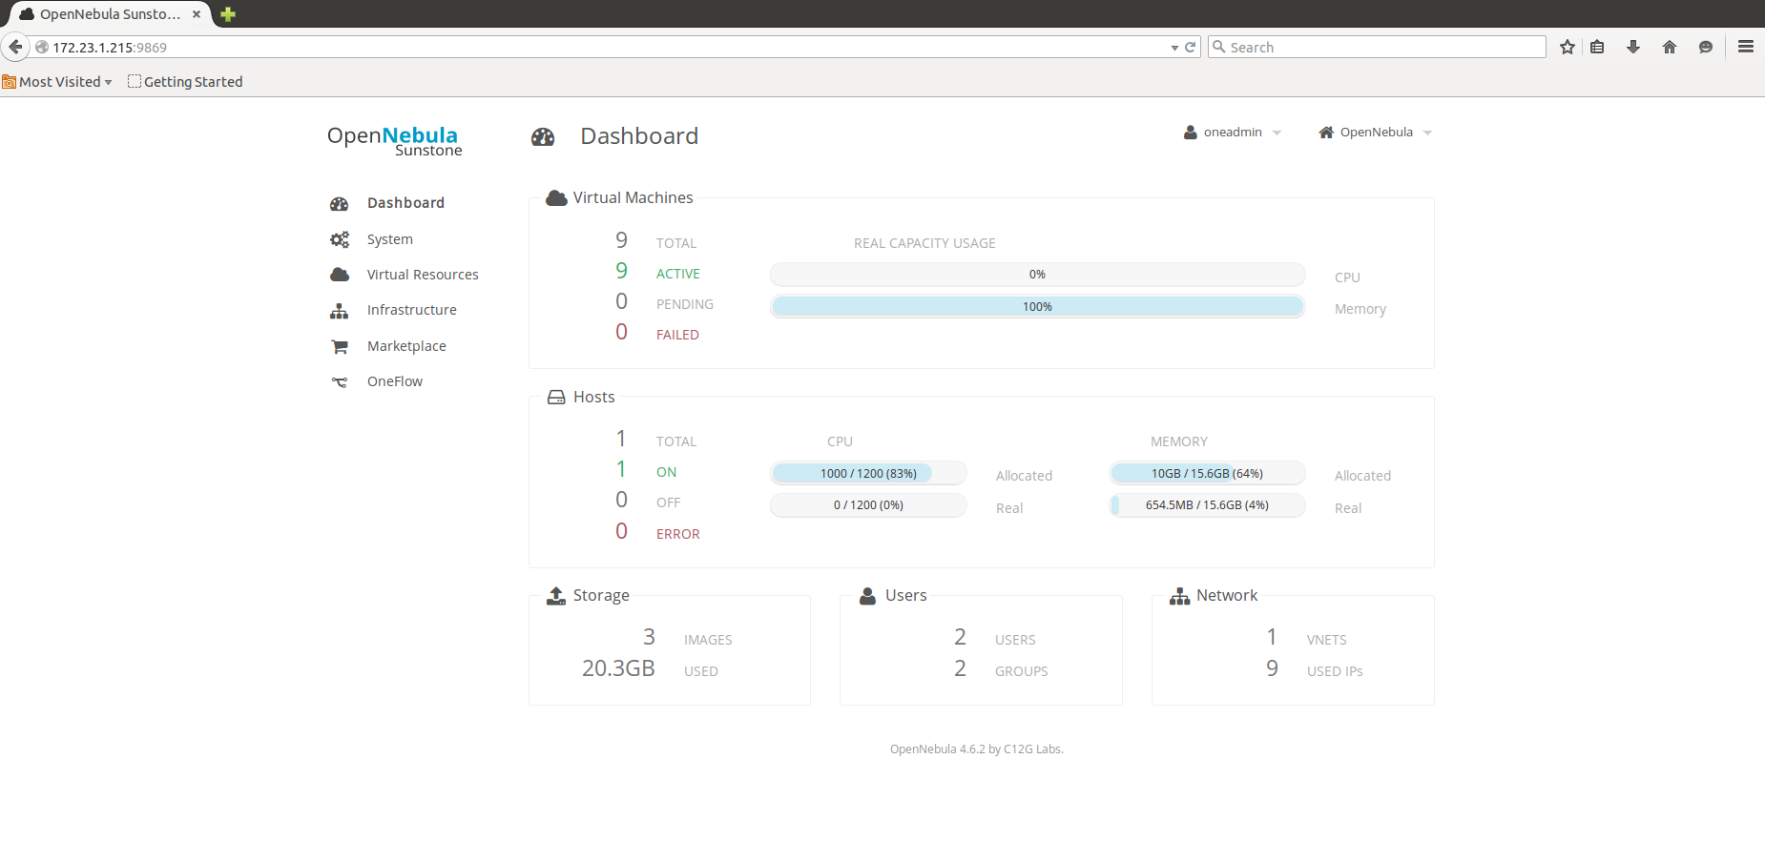
OpenNebula Sunstone: Dashboard
Figure 7.0 Dashboard

Slide 100
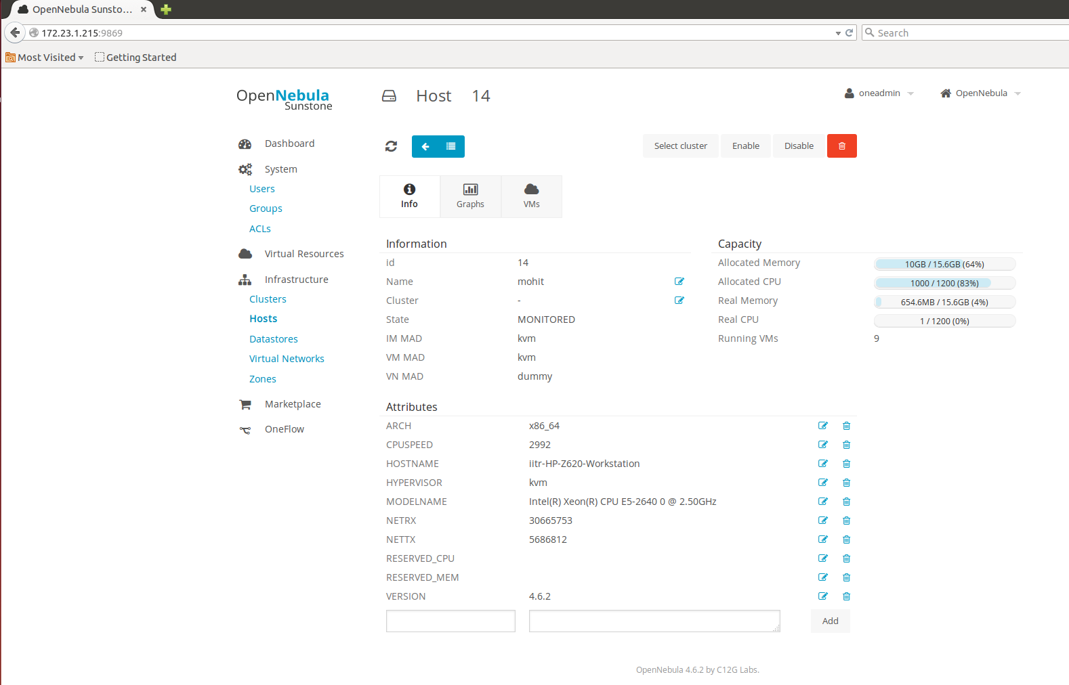
OpenNebula : Host Machine
Figure 8.0 A Host Machine for deploying Virtual Machines

Slide 101
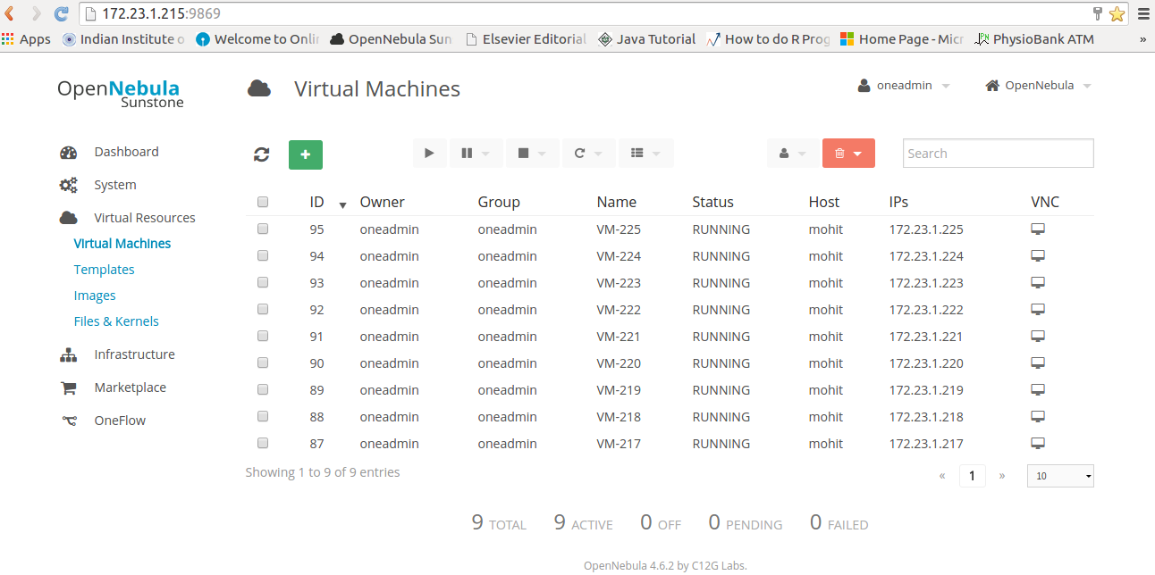
OpenNebula : Virtual Machines
Figure 9.0 A List of Virtual Machines

Slide 102
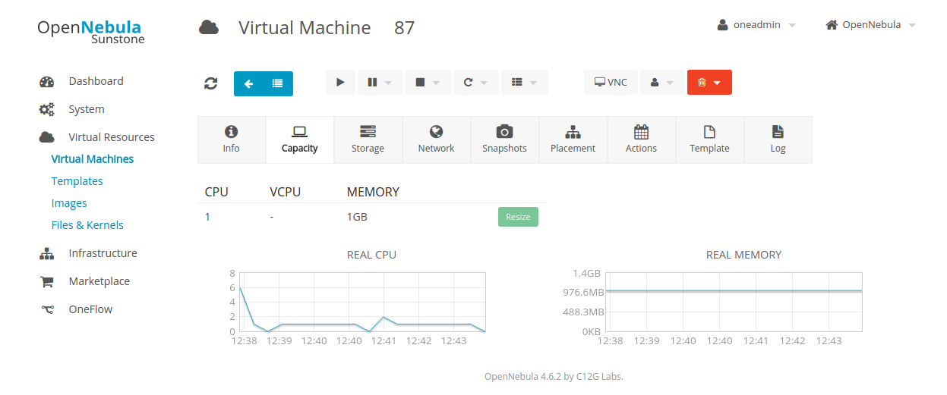
Virtual Machines : Capacity
Figure 10.0 Real CPU and Real Memory of a Virtual Machine

Slide 103
Risks Involved in Cloud Computing
1. Unauthorized access to customer and business data: Hackers and malware are not the only ones who may target a cloud service provider. Cloud computing risks are also presented by insider threats.
More people have access to the data and systems that support the service, which means you have to extend trust to people you have never met.
2. Security risks at the vendor: When a cloud service vendor supplies a critical service for your business and stores critical data – such as customer payment data and your mailing lists – you place the life of your business in the vendor’s hands.
3. Compliance and legal risks: Many data security regulations are intended to protect a specific type of data. For example, HIPAA requires healthcare providers to protect patient data. PCI DSS requires anyone who accepts credit cards to protect cardholder data.

Slide 104
If the company does not have adequate legal protections, then it may be liable when there is a data breach at the cloud service that exposes the company’s data.
4. Risks related to lack of control: When you use a cloud service provider, the vendor is in control. You have no guarantee that the features you use today will be provided for the same price tomorrow. The vendor can double its price, and if your clients are depending on that service, then you might be forced to pay.
5. Availability risks: No service can guarantee 100% uptime. When you rely on a cloud service for a business-critical task, then you are putting the viability of your business in the hands of two services: the cloud vendor and your ISP.
Another cloud risk is that the vendor can go down as well. Anything from bad weather, DDoS attacks, or a good ol’ system failure can knock the service unresponsive.

Slide 105
CloudSim
Motivation: Provides a generalized and extensible simulation framework that enables modeling, simulation, and experimentation of emerging Cloud computing infrastructures and application services.
CloudSim is developed in the CLOUDS Laboratory, at the Computer Science and Software Engineering Department of the University of Melbourne.
CloudSim Toolkit 3.0 released at Jan 13, 2012.
The CloudSim toolkit supports modeling and creation of one or more virtual machines (VMs) on a simulated node of a Data Center, jobs, and their mapping to suitable VMs.
It also allows simulation of multiple Data Centers to enable a study on federation and associated policies for migration of VMs for reliability and automatic scaling of applications.

Slide 106
CloudSim Feature
Support for modeling and simulation of large scale Cloud computing data centers
Energy-aware computational resources
Support for data center network topologies and message-passing applications
Support for dynamic insertion of simulation elements, stop and resume of simulation
Support for user-defined policies for allocation of hosts to virtual machines and policies for allocation of host resources to virtual machines

Slide 107
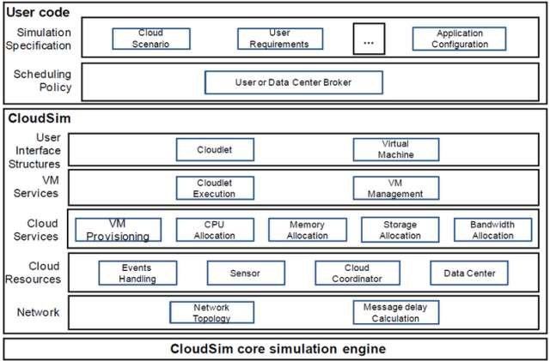
CloudSim Architecture

Slide 108
Reasons for Learning CloudSim
Cloud resource provisioning
Energy-efficient management of datacenter resources
Optimization of cloud computing
Research activities
Limitation: No Graphical User Interface(GUI)

Slide 109
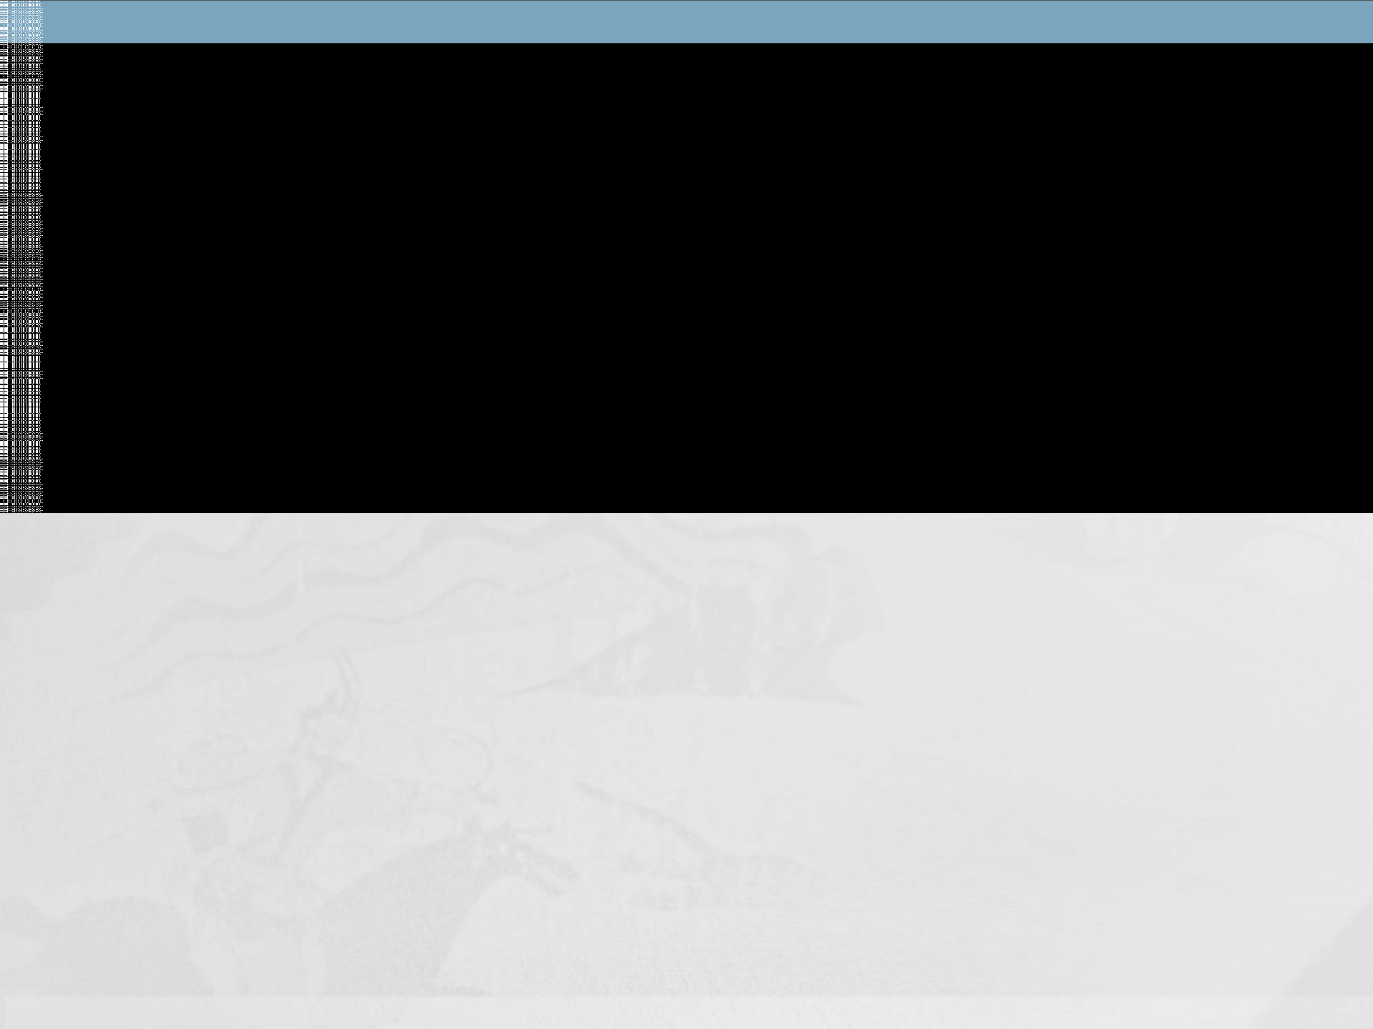
How to use CloudSim with Eclipse
Part 1
Setting up Development Environments
Part 2
Use Ecplise with CloudSim
Part 3
Run sample example using CloudSim

Slide 110
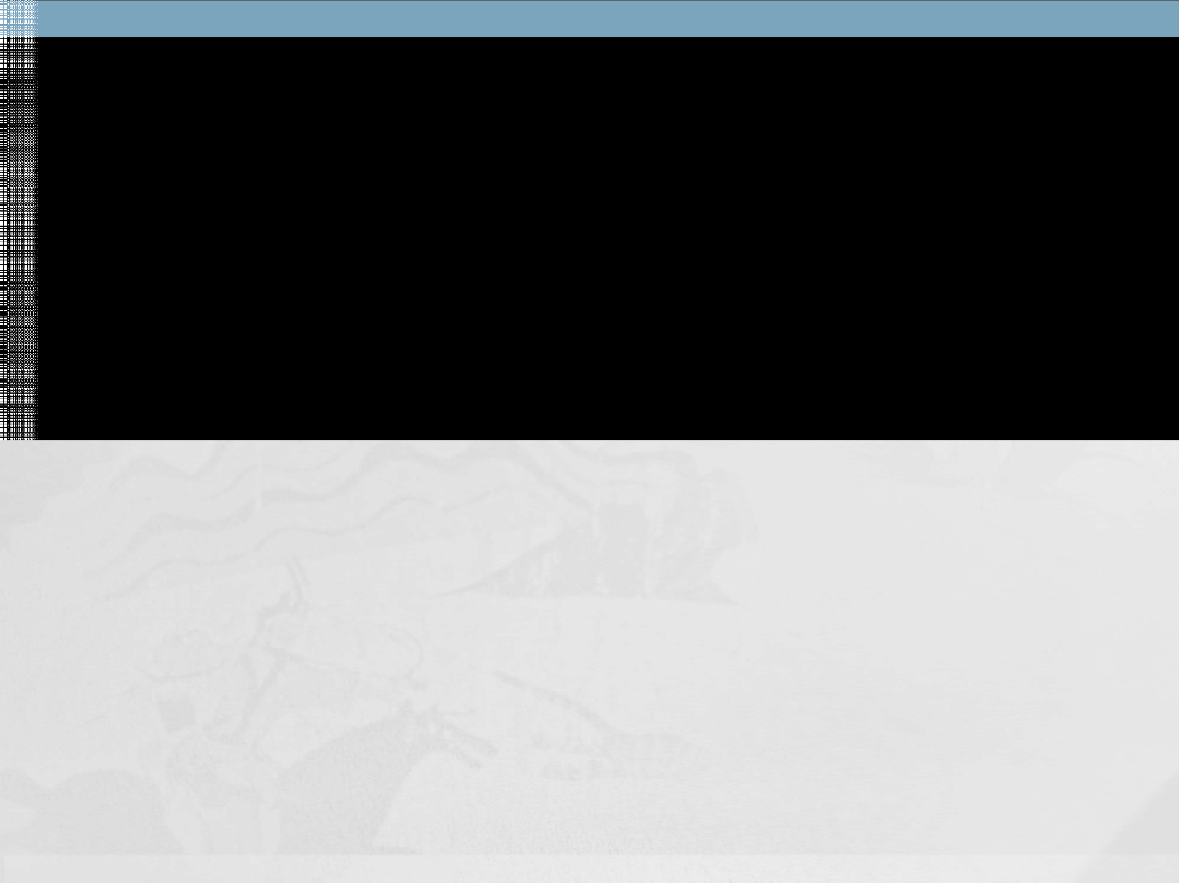
Setting up Development Environments
Supported OS
Windows XP (32-bit), Vista (32- or 64-bit), or Windows 7 (32- or 64-bit)
Mac OS X 10.5.8 or later (x86 only)
Linux (tested on Ubuntu Linux, Lucid Lynx)
Development environment (Eclipse based)
Eclipse Classic (versions 3.5.1 and higher)
JDK 1.6 or later
CloudSim tool kit

Slide 111

Setting up Development Environments (cont.)
To set up the development environment, we need:
Java Development Kit (1.6 is preferable)
Eclipse IDE (classic)

Slide 112

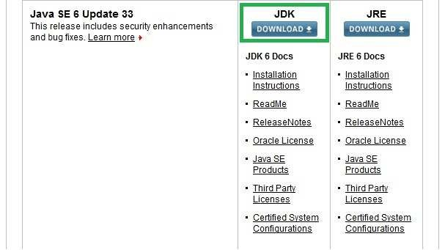
Part 1: Setting up Development Environment(cont.)
 Java Development Kit (JDK) Download Link: http://www.oracle.com/technetwork/java/ja vase/downloads/index.html
Download JDK from here and Install JDK

Slide 113
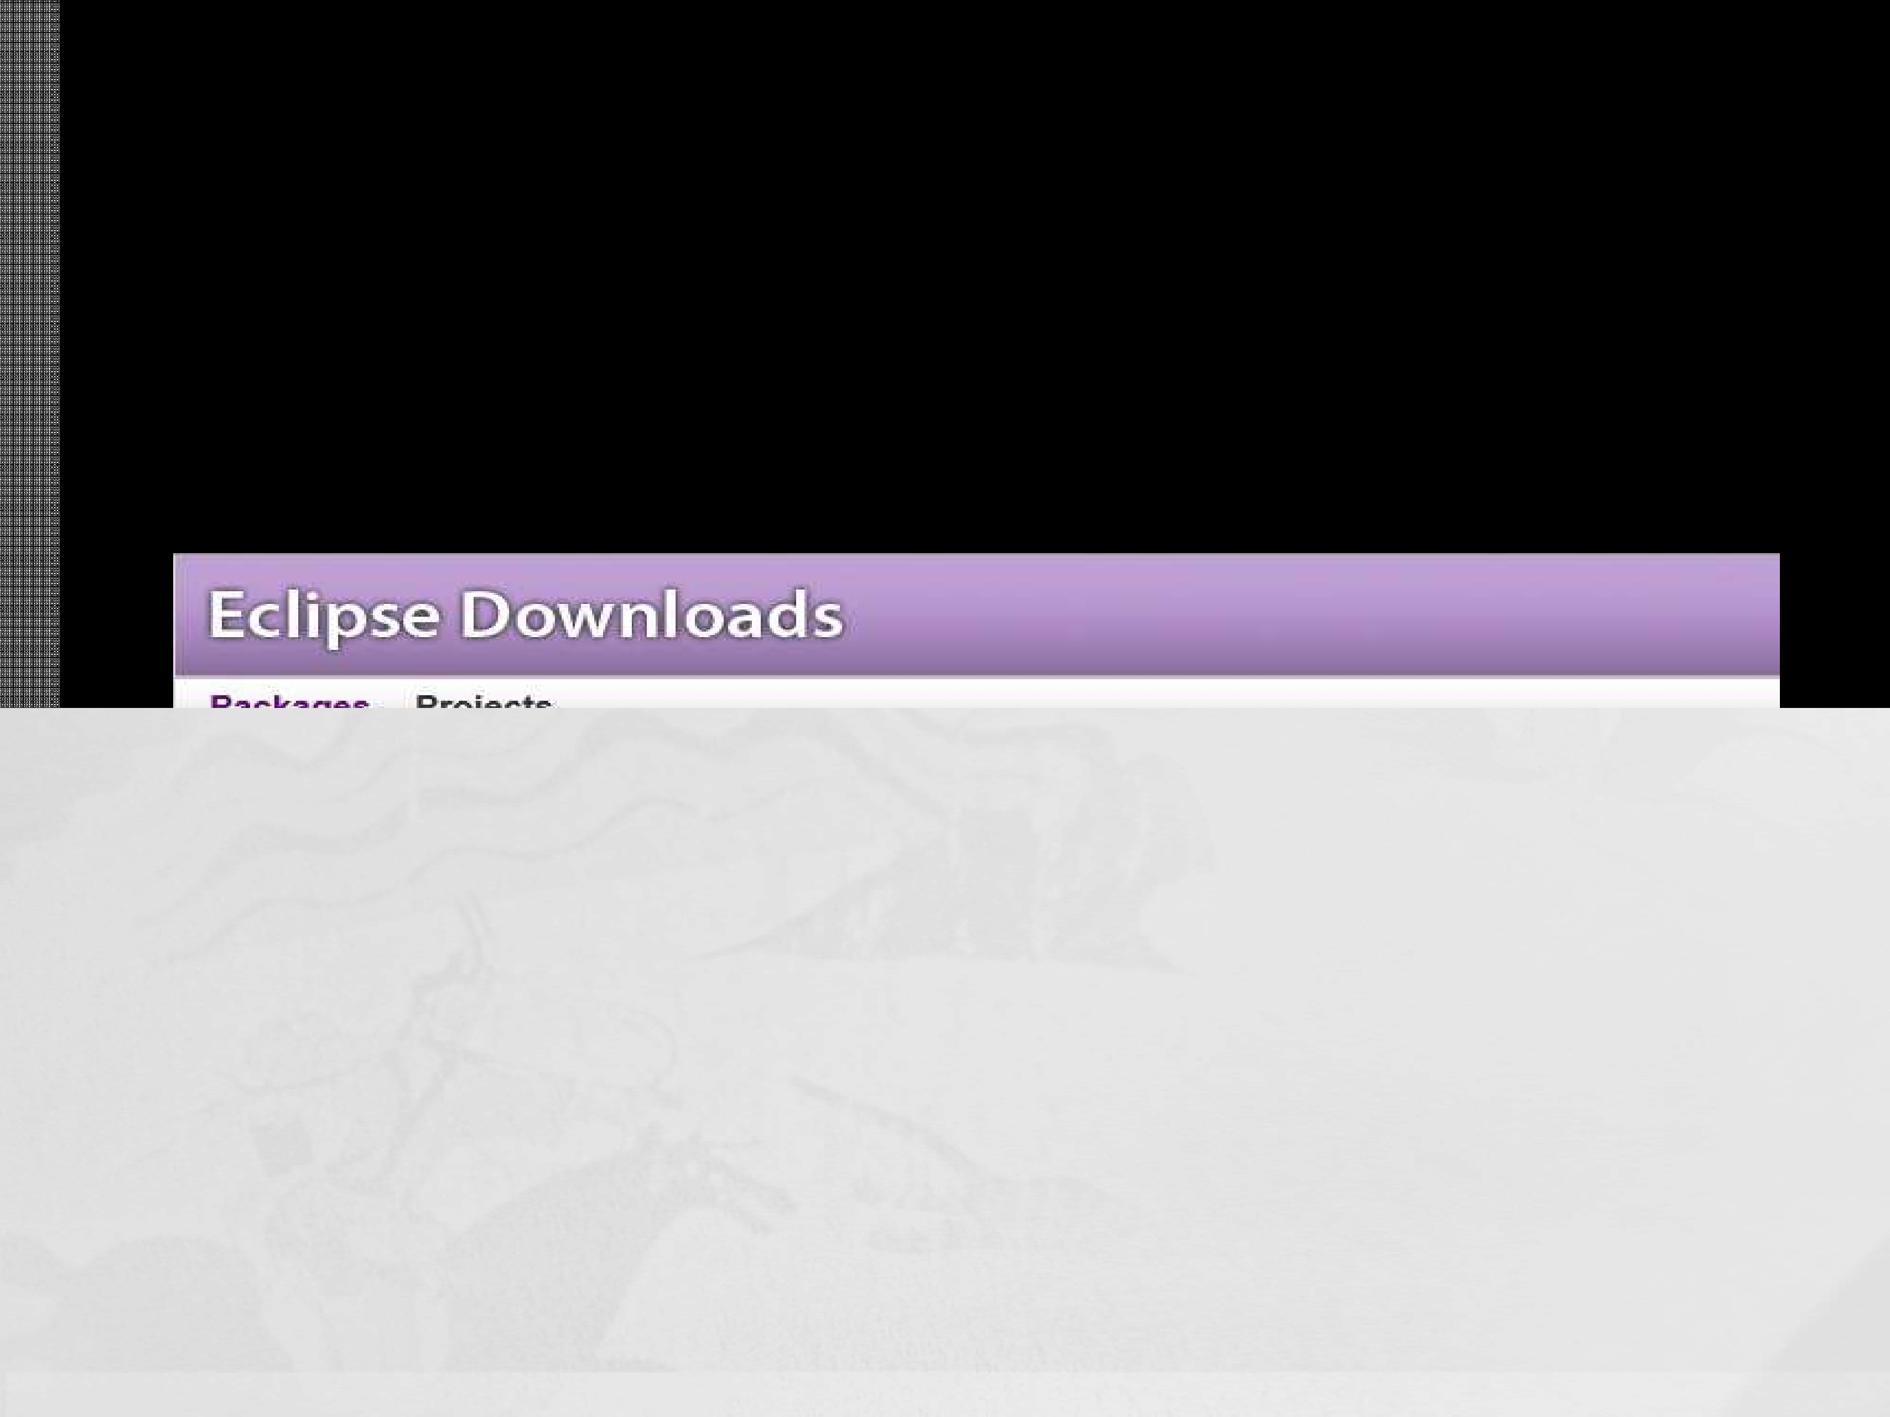
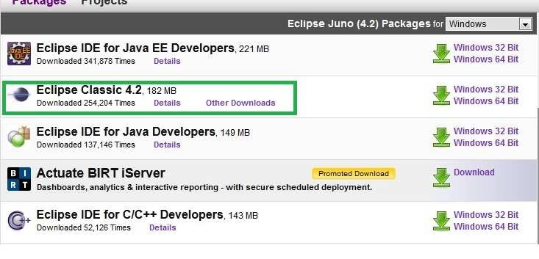
Setting up Development Environment
 Eclipse IDE Download Link: http://www.eclipse.org/downloads/
Download the highlighted version of Eclipse IDE

Slide 114
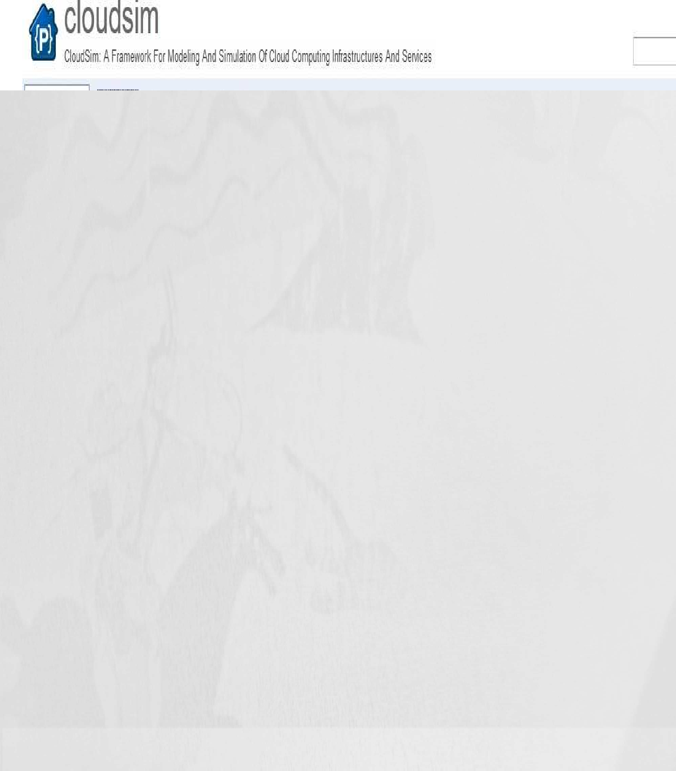
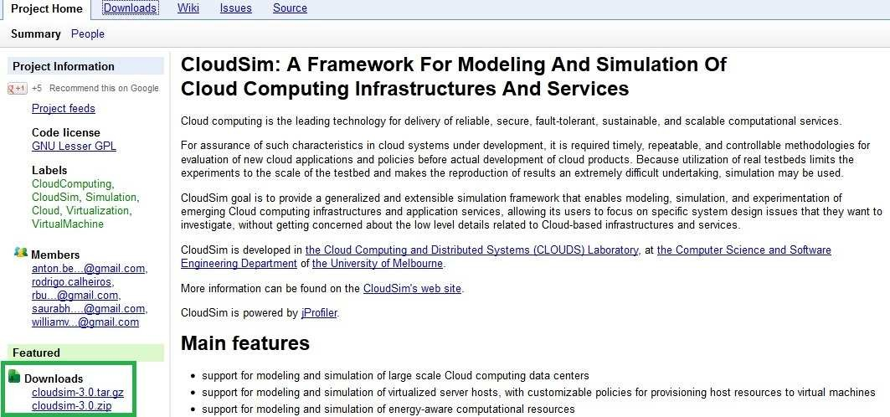
Setting up Development Environment(cont.)
CloudSim Tool Kit Download Link: http://code.google.com/p/cloudsim/downloads
/detail?name=cloudsim-3.0.zip
Download the highlighted version of CloudSim

Slide 115

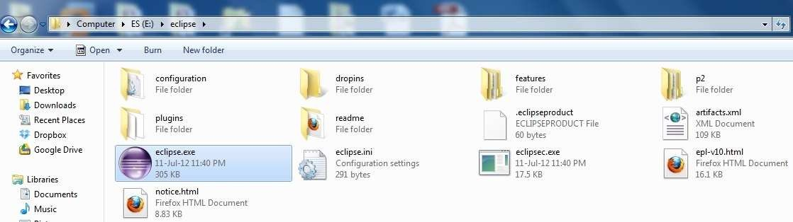
Part 2: How to use Eclipse with CloudSim
Extract Ecplise (in my case: D:\eclipse)
Extract cloudsim-3.0.zip (in my case C:\Users\Habib\Downloads)
To run Ecplise, double click eclipse.exe

Slide 116
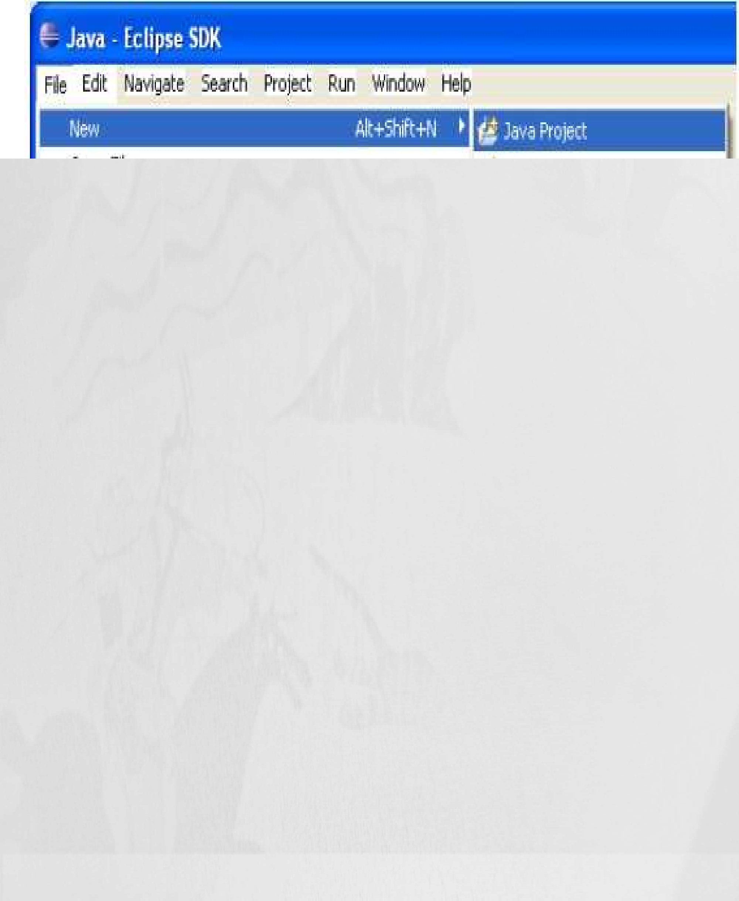

Part 2: How to use Eclipse with CloudSim
OPEN ECLIPSE -> NEW -> JAVA PROJECT

Slide 117





Part 2: How to use Eclipse with CloudSim
Write the Project Name
Untick the USE Default Location
Browse and target it to where you extracted the CloudSim-3.0
On JRE Select JavaSE-1.6 or JavaSE-1.7
Project Layout second option
Click Next

Slide 118





Part 2: How to use Eclipse with CloudSim
Finally you got the RIGHT screen
Select Finish

Slide 119
Part 3: Simulation Example
 CloudSimExample1.java : shows how to create a datacenter with one host and run one cloudlet on it
 CloudSimExample2.java : shows how to create a datacenter with one host and run two cloudlets on it

Slide 120


Step1: Run example using CloudSim
 To create class just right click from “org.cloudbus.cloudsim.examples”, select “New” then “Class”

Slide 121


Step2: Run example using CloudSim
 Write Class name and click “Finish”

Slide 122


Step3: Run example using CloudSim
 To run simulation Select project
 Click “Run” Menu then select “Run Configurations..”

Slide 123


Step4: Run example using CloudSim
 Provide simulation name and select search option to choose an example

Slide 124



Step5: Run example using CloudSim
 Select specific example and press OK

Slide 125


Step6: Run example using CloudSim
 Click “Apply” after select your Main class
 Do Step4 and Step5 if you select another simulation main class for simulation

Slide 126


Step7: Run example using CloudSim
 Click Run to simulate CloudSimExample1

Slide 127


Simulation Result

Slide 128


Simulation Result

Slide 129
Application Scheduling in CloudSim
Scheduling an application/task
– to be executed
– using a resource
– in a cloud environment

Slide 130
Evaluating the Scheduling algorithms
Criteria
Mean execution time/makespan time
Mean user submission time
Average resource utilization
Minimize the cost of applications
Energy Consumption
Reliability/Availability
Scalability/Elasticity
Job/Tasks acceptance ratio or rejection ratio
Throughput

Slide 131
http://www.cloudbus.org/cloudsim/
http://code.google.com/p/cloudsim/downloads/list
http://www.eclipse.org/

Slide 132
Thank You

